Slide 1
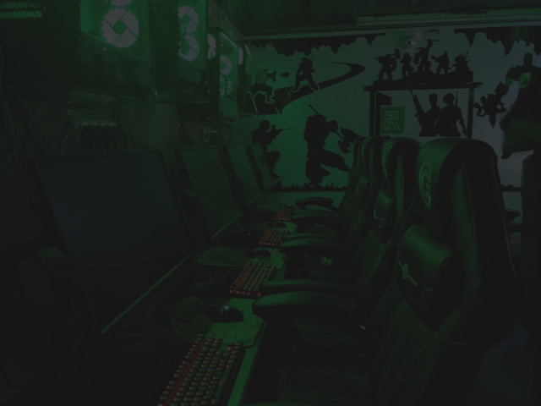

ONE STOP GAMING SOLUTION

Slide 2




Bilal
Ahmed
Muhammad Fahad Imdad
Huzaifa
Mustafa
Muhammad Ali Raza
CEO
CTO
COO
CFO

Slide 3
Points of Discussion
This presentation will cover some of the following points:
01
Problem and solution
02
Market
03
Channels and Funding
04
Revenue Model and streams

Slide 4
Problem
Wastage of gaming talent and prodigies of Pakistan
E-Gaming competitions are not channelized
Lack of professional gaming experience

Slide 5
Solution
01
Available solution
Gaming hub
Nges.pk
Orange gaming zone
Fariya
02
Our solution
Casual gaming zone
Professional gaming on international standards
Professional gaming coaching service
DAZR...WILDEITY...HSB...POKEMON
Professional gaming workshops
Competitive Monthly Tournaments
Hitmarker to compete on international level
Family gaming zone partition

Slide 6

Market
01
02
03
TAM
SAM
SOM
Gaming zone Service : 34.5 B
Coaching Service : 690 B
Total TAM : 724.5 B
Gaming zone Service : 2.5 B
Coaching Service : 50.5 B
Total SAM : 53 B
Gaming zone Service : 150 M
Coaching Service : 3 B
Total SOM : 3.15 B

Slide 7
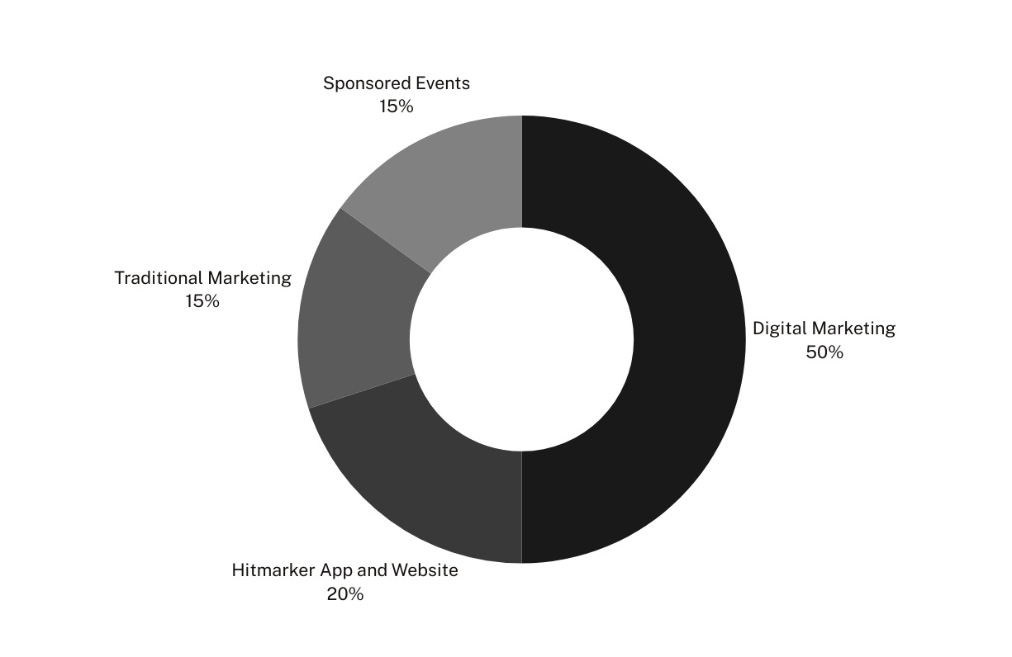
How We
Acquire Customers
Digital Marketing
Hitmarker App and Website
Traditional Marketing
Sponsored Events

Slide 8
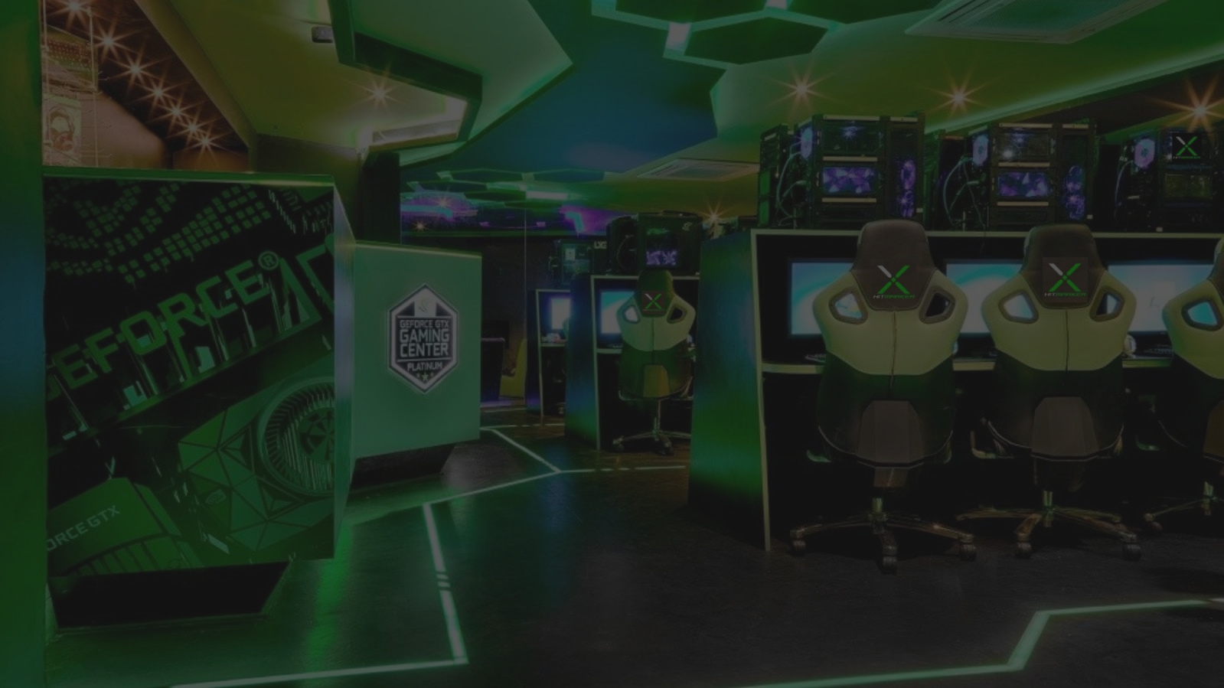

01
Geographic Segmentation
Bahadurabad
Sharfabad
Tariq Road
P.E.C.H.S society
02
Demographic Segmentation
Male: 10 - 45
female: 18 - 25
TARGET MARKET
03
Psychographic Segmentation
Middle to upper class
04
Positioning
One stop gaming solution

Slide 9
Analysis
01
Strengths
02
Weaknesses
First mover advantage
Peer Funding
Slow Progress
Lack of Experience
03
Opportunities
04
Threats
Capitalize an uncontested Market
High Risk - Very High Reward)
Volatility in Internet quality
Electricity Problems, Economic Conditions)

Slide 10
Revenue
model
Revenue
Streams
01
Subscription based model
01
Direct Sales through footfall
02
Sales based model
02
Advertisements
03
Monthly Membership
04
Sponsored Events

Slide 11
Financial Details
01
One time Expense : 6,788,500 PKR
02
Monthly Expenses : 410,000 PKR
03
Revenue : 760,000 PKR
04
Profit : 350,000 PKR

Slide 12
Fundings
01
Bootstrapping
02
Peer funding
03
Gaming sponsors

Slide 13
Advertisement

Slide 14
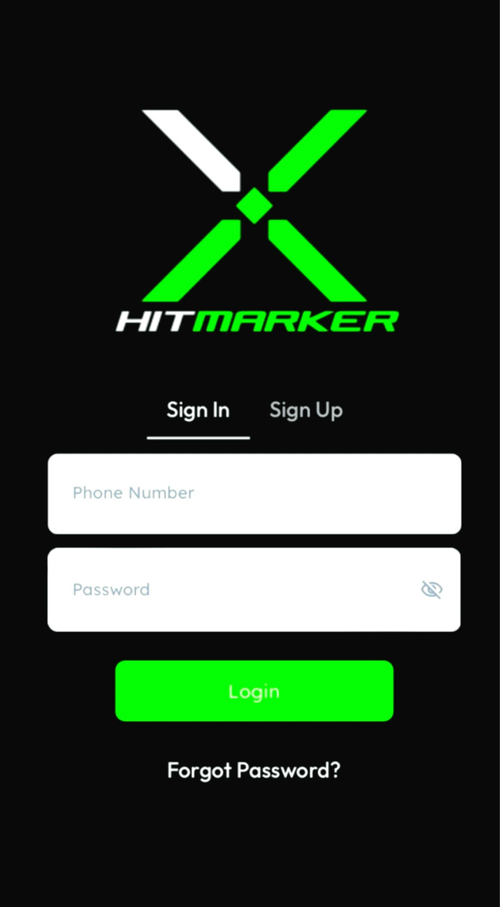


ONE STOP GAMING SOLUTION

Slide 15

Any Questions

Slide 16
Thank you

